Slide 1

CBS Chatbot
Jan, Askin, Niels, Seyma, Timo

Slide 2
Table of contents
Previous Week
Upcoming Week
Findings

Slide 3
Previous Week
Finishing Research plan
01
Subquestion 1
Visualizing Data
03
Subquestion 2
Literature study
02
Online courses
Receiving and process feedback
Experimenting with Natural Language Proces (NLP) models
Plotting the accuracy and learning rate (best type model)
New main question

Slide 4
CSV Reader
Structure
Easier to use
Easier to process
Less initial mistakes
Improved results
Cleaning
Improved methods
Customized to fit all new .csv files
Better findings in general
CSV Reader

Slide 5
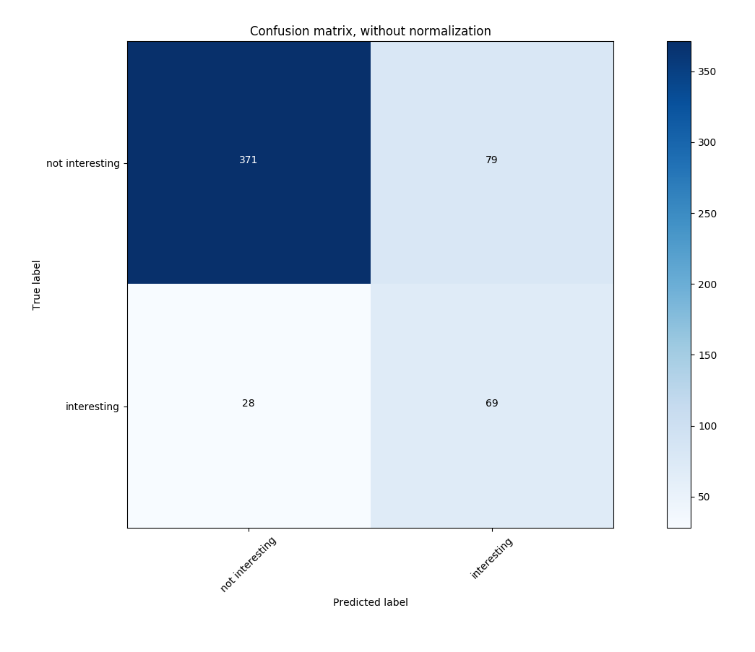
Findings of Visualizing Data
450 sentences
80%
20%
100
sentences
30%
70%
Naïve Bayes Accuracy

Slide 6
Upcoming Python projects
Part-of-Speech tagging
01
Initial testing
Neural Network
02
Preparing for models
Evaluating current sets
Setting a baseline

Slide 7
Upcoming Week
Start Research
01
Neural Networks
CBS
02
Finalizing research proposal
Research paper
Online courses
Convolutional network
Experimenting
03
Recurrent network

Slide 8

Questions?

